Slide 1


(Course Name) Bunker Renovation
Course Conditions & Planning Ideas

Slide 2
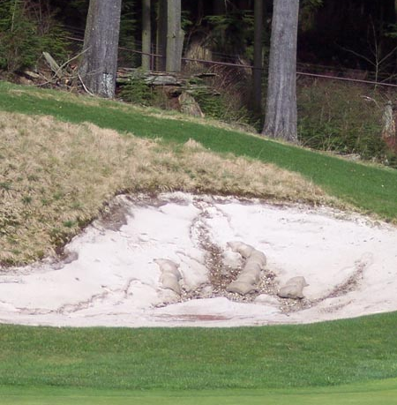

Course Bunkers – Current Realities
A quick statement of average conditions
A quick statement of bunker complaints
A quick statement of maintenance efforts
A quick statement of labor & sand replenishment costs

Slide 3
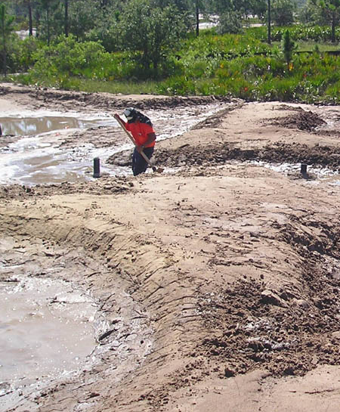
Course Bunkers – The One Thing
Place a brief description here that justifies your idea for pursuing a bunker renovation.
Make a bold statement regarding long-term maintenance cost control, improved bunker conditions, and enhancing the course’s value.

Slide 4
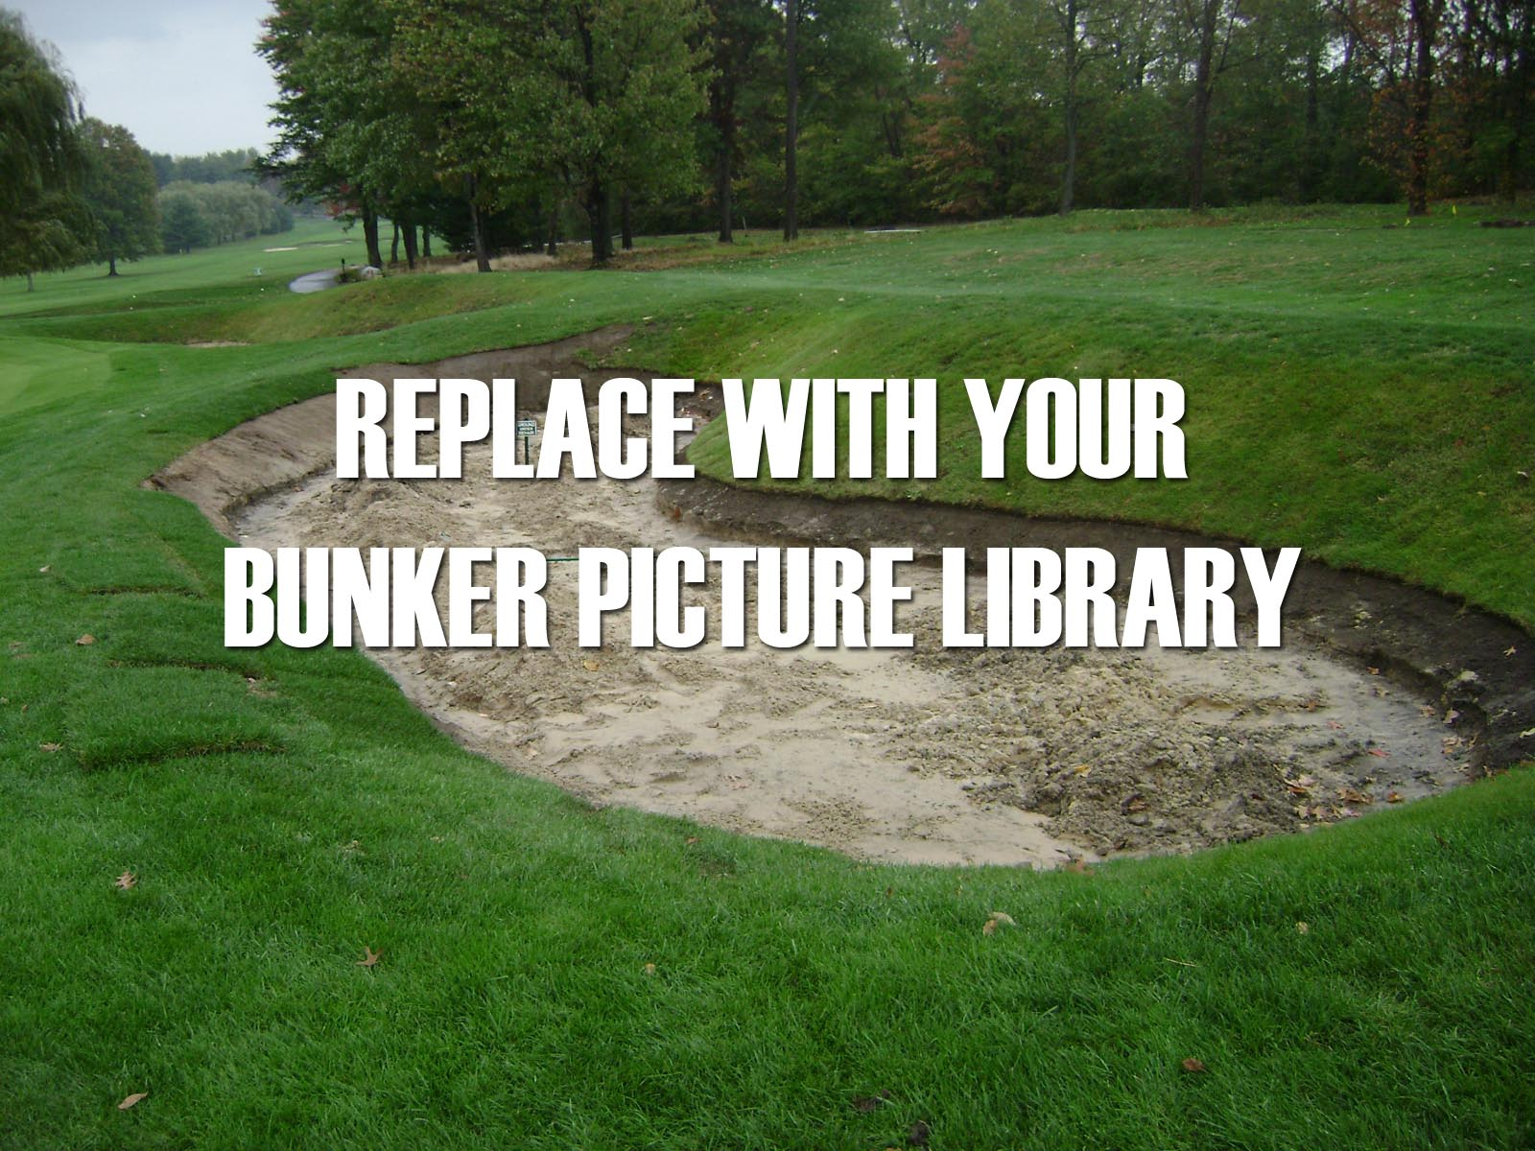
Course Bunkers – Pictoral Review
Place a picture caption here

Slide 5
Course Bunkers – Pictoral Review
Place a picture caption here

Slide 6
Course Bunkers – Pictoral Review
Place a picture caption here

Slide 7
Course Bunkers – Pictoral Review
Place a picture caption here

Slide 8
Course Bunkers – Pictoral Review
Place a picture caption here

Slide 9
Course Bunkers – Current Realities
List Top Maintenance Factors & describe
List Top Maintenance Factors & describe
List Top Maintenance Factors & describe
List Top Maintenance Factors & describe

Slide 10
Course Bunkers – Complaints
List Top Issues Known by Members/Golfers & describe
List Top Issues Known by Members/Golfers & describe
List Top Issues Known by Members/Golfers & describe
List Top Issues Known by Members/Golfers & describe

Slide 11
Course Bunkers – Maintenance Challenges
List Top Maintenance Challenges & describe
List Top Maintenance Challenges & describe
List Top Maintenance Challenges & describe
List Top Maintenance Challenges & describe

Slide 12
Course Bunkers – Maintenance Costs
Estimate & Summarize Bunker Maintenance Costs
Estimate Bunker Labor Hours/Costs
Estimate Sand Replenishment Costs

Slide 13
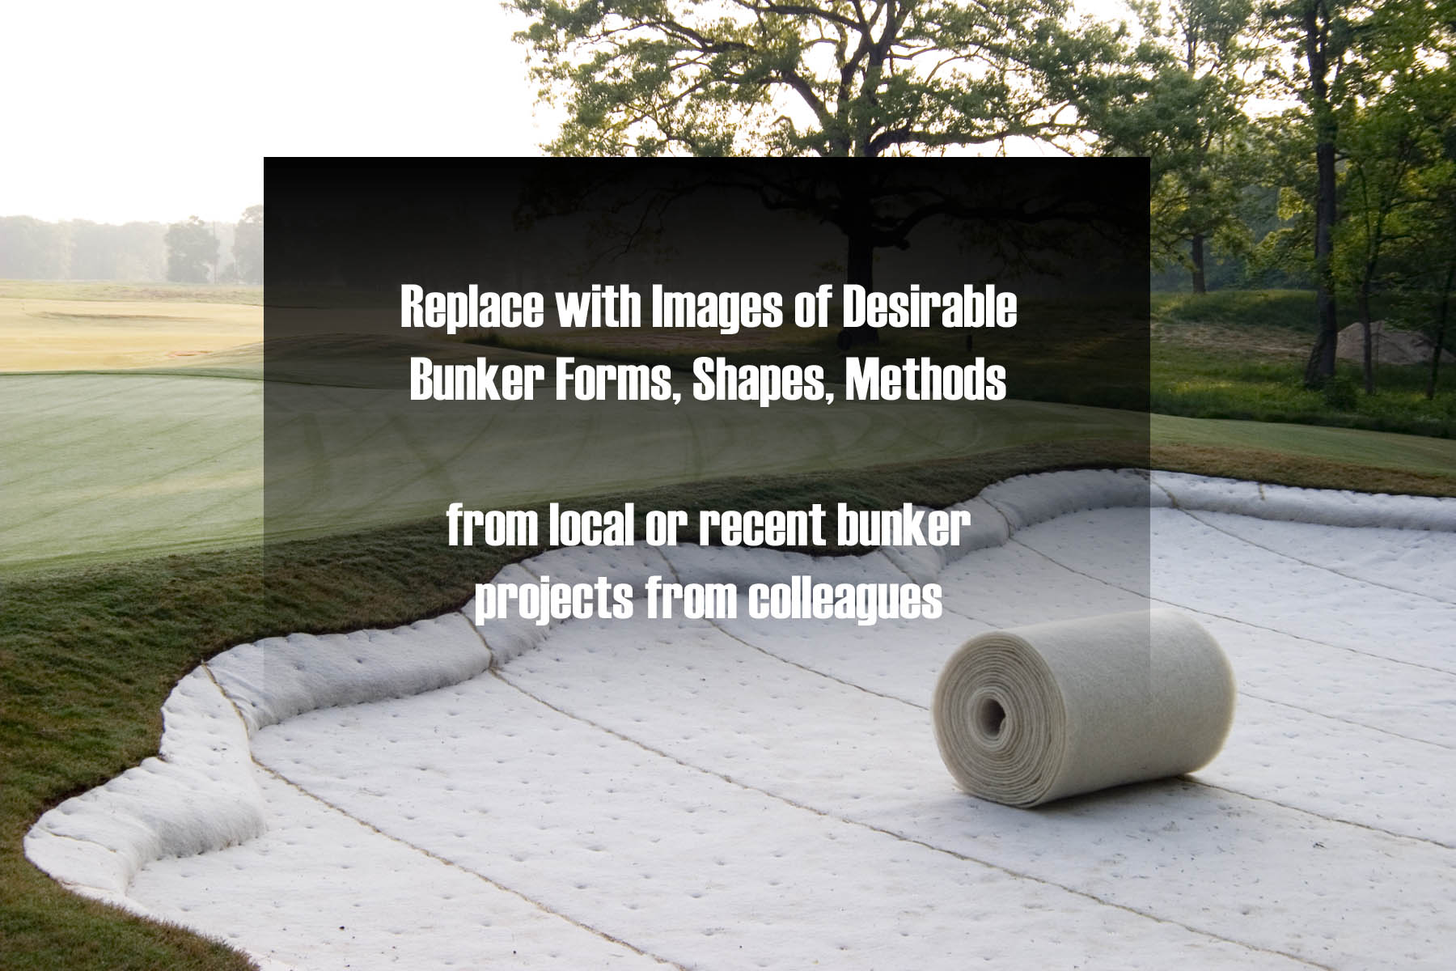
Opportunities – Project Planning
Place a picture caption here

Slide 14
Opportunities – Project Planning
Place a picture caption here

Slide 15
Opportunities – Project Planning
Place a picture caption here

Slide 16
Opportunities – Project Planning
Place a picture caption here

Slide 17
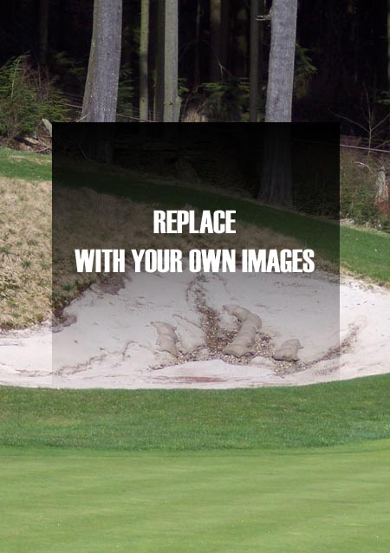
Project Planning – Initial Objectives
Describe your “Wish List”
Describe your “Wish List”

Slide 18
Project Planning – Initial Objectives
Define Your Ideal Project Parameters
Discuss REAL feasibility of a bunker project
Review Basic Implementation Methods Under Consideration
Review Basic Roles & Responsibilities of Planning

Slide 19
Project Planning – Basic Components
Describe Architect Selection
Describe In-House Option
Define Basic Cost Elements

Slide 20
Project Planning – Basic Cost Elements
Project Element | Basic Unit Cost
Architect Fees | $00,000
Builder Mobilization | $00,000
Earth Moving | $0,000/cu. yd
Bunker Prep | $0.00/cu. yd
Drainage | $0.00/lf
Liners | $0.00/sq. ft.
Bunker Sand | $000.00/cu. Yard
Sodding | $0.00/sq. ft.

Slide 21
Project Planning – Next Steps
Define Planning Team Set-Up
Review Basic Planning Communications
Review Planning Timetables
Address Preliminary Project Management Ideas

Slide 22
Project Planning – Next Steps
Discuss Approval for Continued Planning
Discuss Planning Parameters

