Slide 1
(Course Name) Bunker Renovation
Add Your Own Attention-Getting Sub-Heading

Slide 2
Bunker Renovation Planning - Introductions
Introduce Your Team Members
Acknowledge Specific Contributions

Slide 3
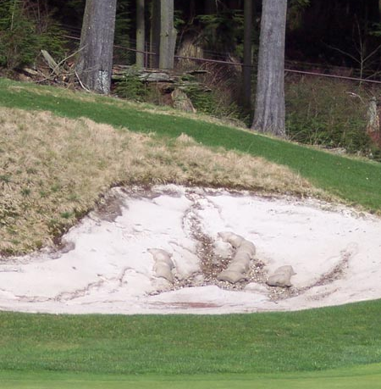
Course Bunkers – Solutions & Benefits
A quick statement of average conditions
A quick statement of bunker complaints
A quick statement of maintenance efforts
A quick statement of labor & sand replenishment costs

Slide 4
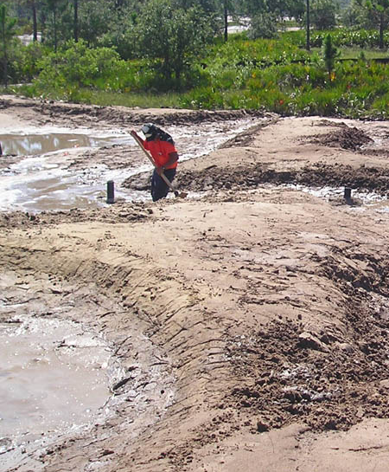
Bunker Renovation – The One Thing
Place a brief description here that justifies your idea for pursuing a bunker renovation.
Make a bold statement regarding long-term maintenance cost control, improved bunker conditions, and enhancing the course’s value.

Slide 5
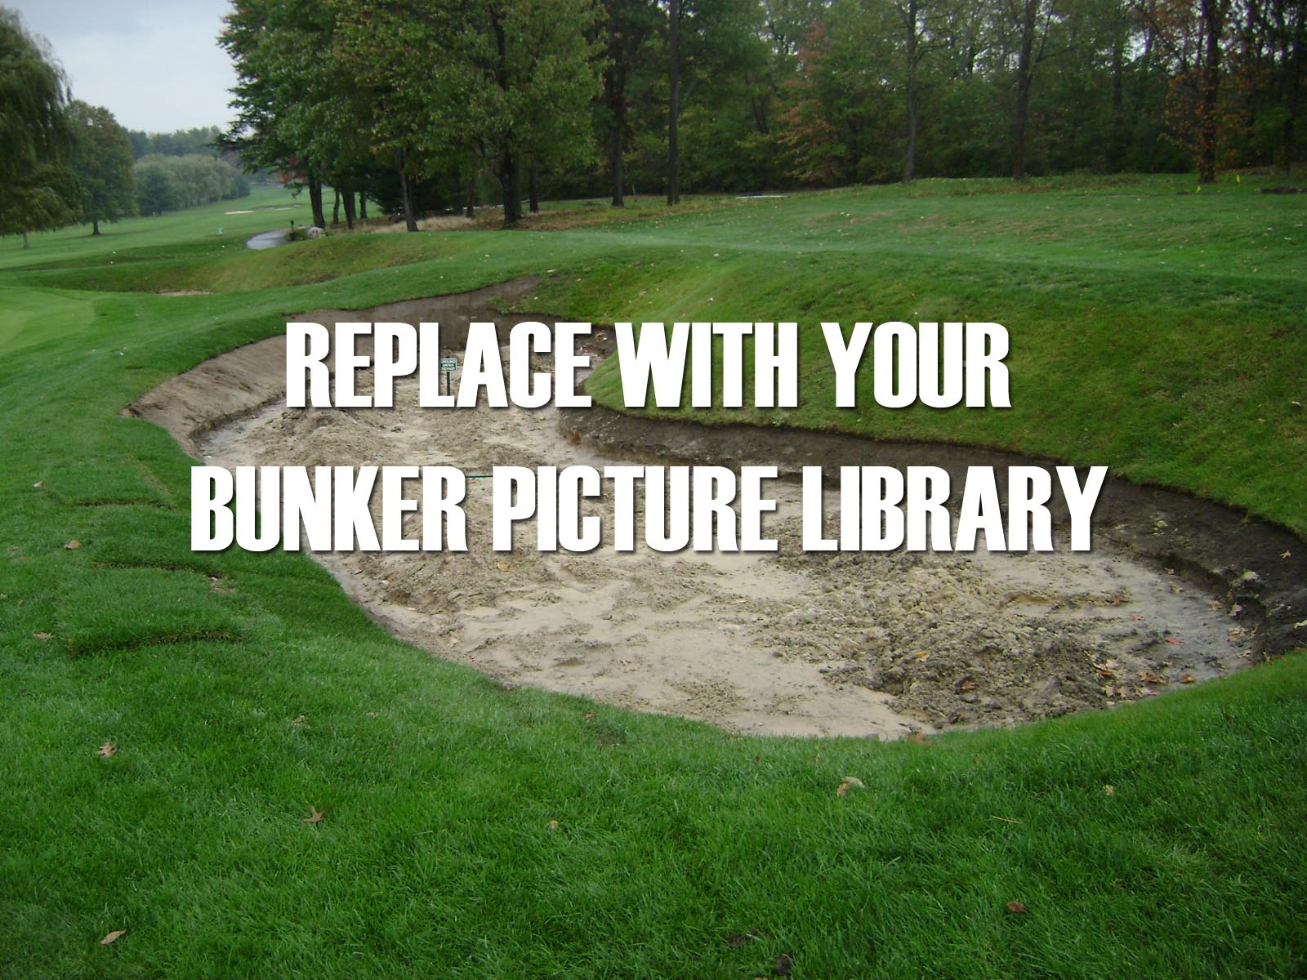
Course Bunkers – Pictoral Review
Place a picture caption here

Slide 6
Course Bunkers – Pictoral Review
Place a picture caption here

Slide 7
Course Bunkers – Pictoral Review
Place a picture caption here

Slide 8
Course Bunkers – Pictoral Review
Place a picture caption here

Slide 9
Course Bunkers – Pictoral Review
Place a picture caption here

Slide 10
Course Bunkers – Current Realities
List Top Maintenance Factors & describe
List Top Maintenance Factors & describe
List Top Maintenance Factors & describe
List Top Maintenance Factors & describe

Slide 11
Course Bunkers – Complaints
List Top Issues Known by Members/Golfers & describe
List Top Issues Known by Members/Golfers & describe
List Top Issues Known by Members/Golfers & describe
List Top Issues Known by Members/Golfers & describe

Slide 12
Course Bunkers – Maintenance Challenges
List Top Maintenance Challenges & describe
List Top Maintenance Challenges & describe
List Top Maintenance Challenges & describe
List Top Maintenance Challenges & describe

Slide 13
Course Bunkers – Maintenance Costs
Estimate & Summarize Bunker Maintenance Costs
Estimate Bunker Labor Hours/Costs
Estimate Sand Replenishment Costs

Slide 14
Bunker Renovation – Project Structure
Owner
Architect
Superintenent
Builder
Consultant
Place your Implementation method here

Slide 15
Bunker Renovation – Project Structure
Discuss Advantages of Selected Project Structure
Discuss Options, if neccessary
Estimate Sand Replenishment Costs

Slide 16
Bunker Renovation – Imporvements Defined
Discuss Top Issues to be Improved
Discuss How Priorities Were Defined
Examples of Other Similar Projects

Slide 17
Opportunities – Proven Methods
Place a picture caption here

Slide 18
Opportunities – Proven Methods
Place a picture caption here

Slide 19
Opportunities – Proven Methods
Place a picture caption here

Slide 20
Opportunities – Proven Methods
Place a picture caption here

Slide 21
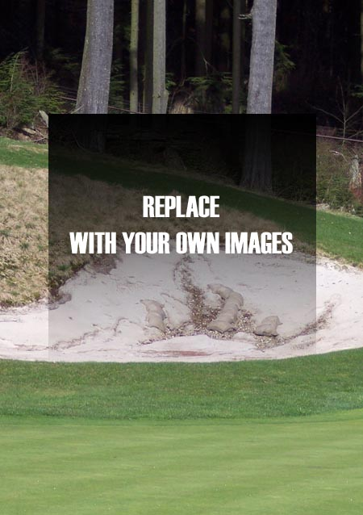
Bunker Renovation – Design Concepts
Describe your “Wish List”
Describe Prospective Architect Design Concepts
Review Alternatives & Trade-Offs
Review Proven Renovation Methods

Slide 22
Bunker Renovation – Project Scope
Define Your Parameters Here

Slide 23
Bunker Renovation – Architect Selection
Review Selection Criteria
Highlight Candidate Qualifications
Discuss Final Architect Selection
If included, have Architect present full design ideas & alternatives
Contractual Arrangements

Slide 24
Bunker Renovation – Builder Selection
Review Selection Criteria
Highlight Candidate Qualifications
Discuss Final Contractor Selection
Contractual Arrangements
If an In-House Project, discuss basic Team capabilities

Slide 25
Bunker Renovation – The Bidding Process
Review Bidding Standards
Discuss Line Item Costs

Slide 26
Bunker Renovation – Projected Schedule
Summarize Basic Timing
List Your Milestones Here
List Your Milestones Here
List Your Milestones Here
List Your Milestones Here
List Your Milestones Here

Slide 27
Bunker Renovation – Project Management
Summarize Project Start Up Issues
Review Internal/External Communications
Discuss Impact to Course/Members/Golfers
Discuss Internal Team Responsibilites

Slide 28
Bunker Renovation – Project Management
Summarize Project In-Process Issues
Review Proposed Construction Schedule
Review Plans for Change Management
Review Plans for Financial Management

Slide 29
Bunker Renovation – Sand Selection
Summarize Sand Requirements
Discuss Sand Acquisition Alternatives

Slide 30
Bunker Renovation – Sand Selection
Summarize Sand Requirements
Discuss Sand Acquisition Alternatives

Slide 31
Bunker Renovation – Sand Selection
Summarize Sand Requirements
Discuss Sand Acquisition Alternatives

Slide 32
Bunker Renovation – Line Item Csts
Project Element | Basic Unit Cost
Builder Mobilization | $00,000
Earth Moving | $0,000/cu. yd
Bunker Prep | $0.00/cu. yd
Drainage | $0.00/lf
Liners | $0.00/sq. ft.
Bunker Sand | $000.00/cu. Yard
Sodding | $0.00/sq. ft.
Totals | $000,000.00

Slide 33
Bunker Renovation – Line Item Csts
Project Element | Basic Unit Cost
Builder Mobilization | $00,000
Earth Moving | $0,000/cu. yd
Bunker Prep | $0.00/cu. yd
Drainage | $0.00/lf
Liners | $0.00/sq. ft.
Bunker Sand | $000.00/cu. Yard
Sodding | $0.00/sq. ft.
Totals | $000,000.00

Slide 34
Bunker Renovation – Line Item Csts
Project Element | Basic Unit Cost
Builder Mobilization | $00,000
Earth Moving | $0,000/cu. yd
Bunker Prep | $0.00/cu. yd
Drainage | $0.00/lf
Liners | $0.00/sq. ft.
Bunker Sand | $000.00/cu. Yard
Sodding | $0.00/sq. ft.
Totals | $000,000.00

Slide 35
Bunker Renovation – Benefits
Define Impact to Course
Define Changes/Improvements to Maintenance
Improving Bunkers as a Course Asset
Strategic & Playability

Slide 36
Project Planning – Next Steps
Discuss Approval for Continued Planning
Discuss Planning Parameters

